Slide 1

BTMW 4012: TECHNOLOGY ENTREPRENEURSHIP FORMATION & REGISTRATION OF BUSINESS IN MALAYSIA
Lecture 3
FPTT- UTeM

Slide 2
EQUATION OF A STARTUP
New Business
Innovation
Technology
Startup
Passion

Slide 3
T H E Y A R E C R E A T I N G
D I S R U P T I O N

Slide 4

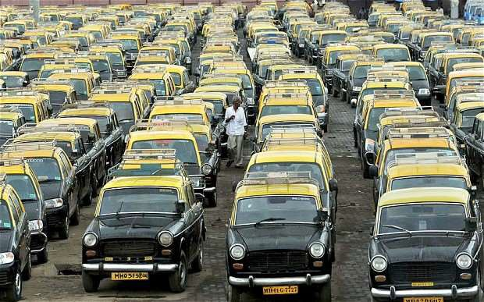

Disruption in Taxi Services
Then
now

Slide 5

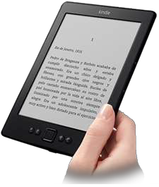

Disruption in books
Then
now

Slide 6
Types of Ideas That Develop into Startups
New Market
New Technology
New Benefit
Example: Providing health conscious Utah consumers with fruit smoothies.
Example: Providing alternatives to incarceration by using high technology ankle bracelets for home arrest programs.
Example: Providing same day drain cleaning services with a money-back guarantee.
New Market: Providing customers with a product/ service that is not in their market but already exists elsewhere. New Technology: Using a new technical process that provides the basis for new product or service ideas. New Benefit: Performing an old function for customers but in a new and improved way.

Slide 7
Sources of Startup Ideas
Personal Interest/Hobby 16%
Friends/Relatives 5%
Family Business 6%
Suggestion 7%
Education/Courses 6%
Prior Work Experience 45%
Chance Happening 11%
Source: Data developed and provided by the National Federation of Independent Business Foundation and sponsored by American Express Travel Related Services Company, Inc.
Other 4%

Slide 8

INTRODUCTION
Technopreneurs need to know the forms of business organizations available and the strengths and weaknesses of each business form before they register their business.
They should also be aware of the rules and regulations governing business organizations and the business support system available for them.
FPTT - UTeM

Slide 9
INTRODUCTION
It is the responsibility of all business operators who conduct business activities with the objective of making profit to register their businesses. The registration works to legalize a company’s business activities.
Business registration in Malaysia is managed by the Companies Commission of Malaysia (SSM), an agency under the Ministry of Domestic Trade, Consumer Affairs, Cooperative and Consumerism.

Slide 10
Introduction (cont.)
Basically, there are four types of business entities that must be registered with the SSM—sole proprietorship, partnership, limited liability partnerships and private limited companies.
Cooperatives are another option of doing business. Cooperatives have different objectives and the registration must be done at the Cooperatives Commission of Malaysia (SKM).
Each of the entity above has its own advantages and disadvantages, which should be considered by an entrepreneur prior to registration.

Slide 11
Types of Business Entities in Malaysia
Sole proprietorship
A sole proprietorship is a business entity that is solely owned, funded and managed by one owner only. Sole proprietorship is the most popular and the simplest or easiest form of business entity in Malaysia.
Partnership
A partnership is a business entity that is owned by two or a maximum of 20 people. However, for professional businesses such as accounting, legal, quantity surveyors, architects, engineer firms, etc., the maximum number of members could be up to 50 people.
Both Sole Proprietorship and Partnership business entities are registered under the Business Registration Act 1956.

Slide 12
Types of Business Entities in Malaysia (cont.)
Limited Liability Partnership (LLP)
Limited Liability Partnership (LLP) is an alternative business vehicle regulated under the Limited Liability Partnerships Act 2012, which combines the characteristics of a private limited company and a conventional partnership.
LLP has a legal personality separate from partners (separate legal entity), like private limited company.
LLP has perpetual succession and offers benefits of a private limited company without the painful reporting requirements.

Slide 13
Types of Business Entities in Malaysia (cont.)
The LLP concept also supports start-ups, small and medium enterprises (SMEs), joint ventures and venture capitals to grow without having to worry too much about personal liabilities, personal assets and strict compliance requirements.
An LLP can be formed by a minimum of two persons up to an unlimited number of members.

Slide 14
Types of Business Entities in Malaysia (cont.)
Private Limited Company
A business that is registered as a company is allotted under the Companies Act 1965. A company is a body that has a legal entity separate from members or the founder.
The concept of a company is based on several individuals who are entrepreneurs contributing to a bigger capital sourcing to make the business easily manageable and expandable.

Slide 15
Types of Business Entities in Malaysia (cont.)
Several improvements have been made in the Companies Act 2016 whereby the total number of members or partners in a company starts from a minimum of one or single director to a maximum of 50 individuals.
All kinds of management and monetary financing in the company is contributed by and among members, based on ownership percentage, from the total agreed upon by all.

Slide 16
Types of Business Entities in Malaysia (cont.)
Shareholders liability is limited to the amount of share own or held by the members only.
The establishment of a company is quite complicated. For example, there is legal requirements to appoint a Company Secretary responsible for company’s secretarial function and an Auditor responsible for financial matters and financial reporting.

Slide 17
Types of Business Entities in Malaysia (cont.)
There are two legal documents that should be completed to form a private limited company: the Memorandum of Association and Articles of Association.
A Private Limited Company is not allowed to invite the public to buy company shares.
This type of company must use ‘Sendirian Berhad’ or ‘Sdn Bhd’ at the end of the company name.

Slide 18
Types of Business Entities in Malaysia (cont.)
Cooperative
A cooperative (also known as co-operative, co-op or coop) is an autonomous association of people united voluntarily to meet common economic, social and cultural needs and aspirations through a jointly owned and democratically controlled business.
In Malaysia, the minimum number of members in a primary cooperative is 100; and in the Farmers’ Cooperative, it is 50.

Slide 19
Types of Business Entities in Malaysia (cont.)
A cooperative has a separate legal entity and members, directors, managers and employees are not liable for any debts incurred unless the debts are the result of recklessness, negligence or fraud, or if the members were guarantors to the cooperative’s loan.
A cooperative usually only allows a limited distribution of profits to members.
Every cooperative society must be registered under the cooperatives law, supervised by the Malaysia Co-operative Society Commission or Suruhanjaya Koperasi Malaysia (SKM).

Slide 20
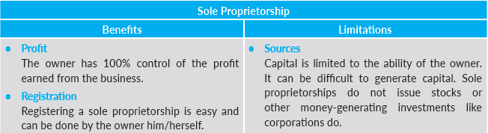
Benefits and Limitations of Sole Proprietor

Slide 21
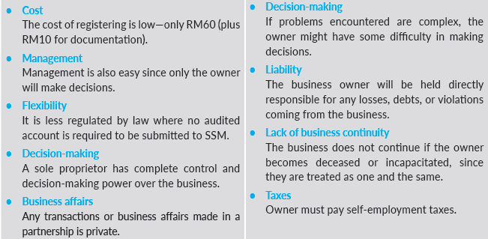
Benefits and Limitations of Sole Proprietor (cont.)

Slide 22
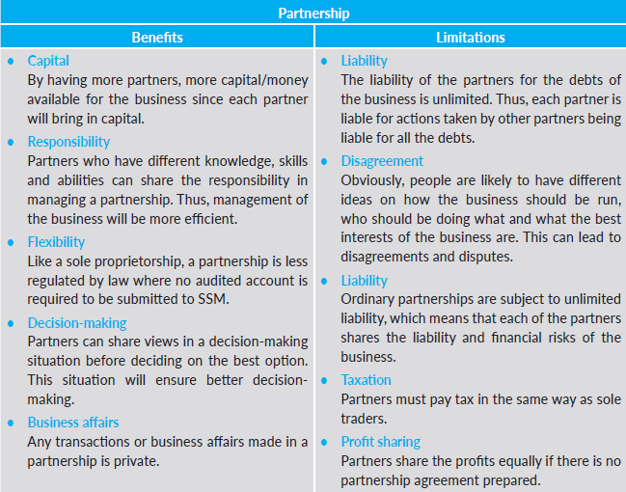
Benefits and Limitations of Partnership

Slide 23
What if there is NO contract agreement? How is the business managed WITHOUT a contract agreement?
FPTT - UTeM

Slide 24

Section 26 and 27 of the Act (To cover those business entities without contract agreement)
Profits or losses are to be shared equally.
No interest is payable on partners’ capital.
Each partner is entitled to actively participate in the management of the business.
No partner is entitled to a salary for participating in the partnership business.
Partners have the right to be paid based on their contribution to the business.
FPTT - UTeM

Slide 25
Section 26 and 27 of the Act (Cont’.)
Daily normal things in business can be decided by the majority of the partners, but any changes that regularly occur need to be made with consensus from all partners.
A partner may withdraw after getting the consent of the other partners.
The introduction of a new partner must have the unanimous consent of all existing partners.
All business accounts books need to be kept at the main business premises. Partners are allowed to check through the books and they have the right to keep a copy of the books.
FPTT - UTeM

Slide 26
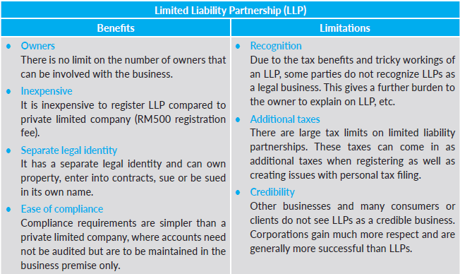
Benefits and Limitations of Limited Liability Partnership

Slide 27
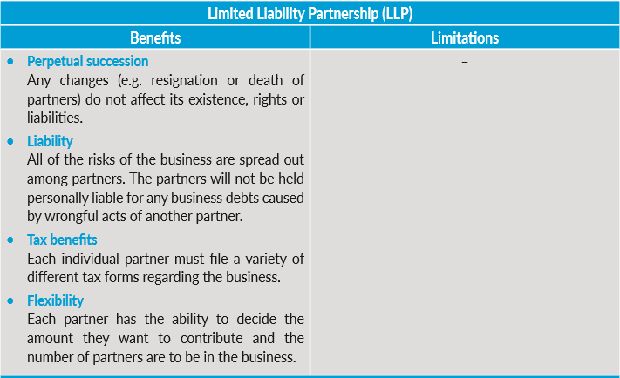
Benefits and Limitations of Limited Liability Partnership (Cont.)

Slide 28
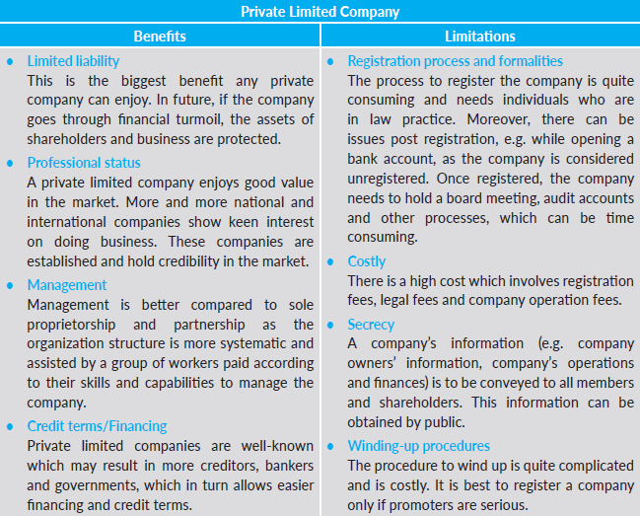
Benefits and Limitations of Private Limited Company

Slide 29
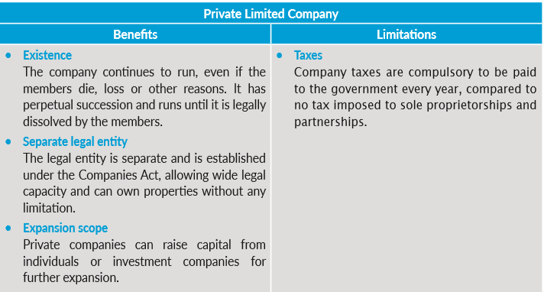
Benefits and Limitations of Private Limited Company (cont.)

Slide 30
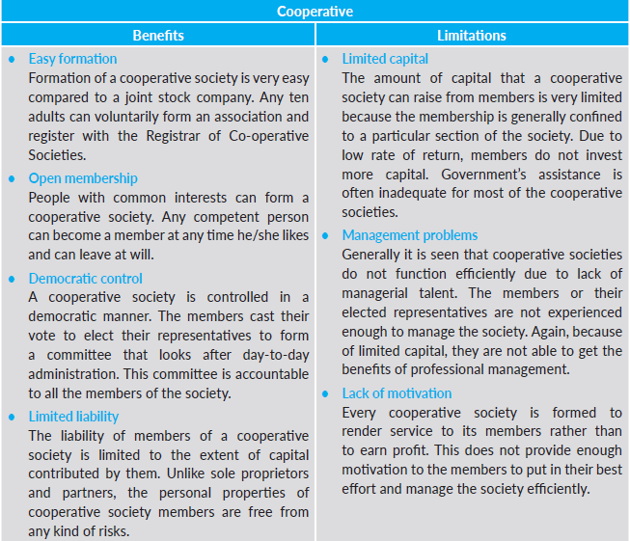
Benefits and Limitations of Cooperative

Slide 31
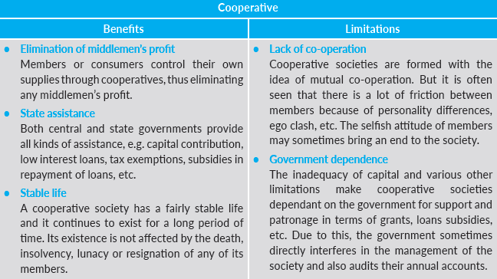
Benefits and Limitations of Cooperative (cont.)

Slide 32
Registration Procedures
A start-up entrepreneur will need to know where and how to register the business entity. There are only two places to register:
the Companies Commission of Malaysia, or
the Cooperative Commission of Malaysia.
For more details, visit the websites available: www.ssm.com.my and www.skm.com.my.

Slide 33




ETHICS

Slide 34




Slide 35



Slide 36


Slide 37
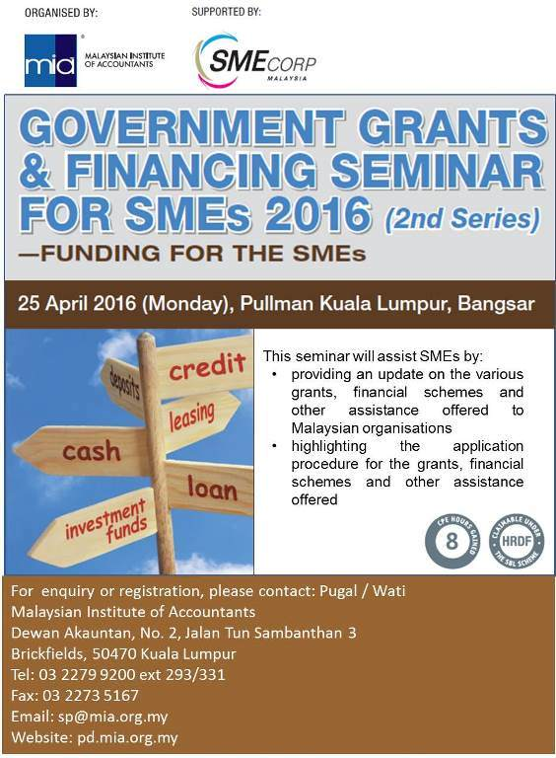
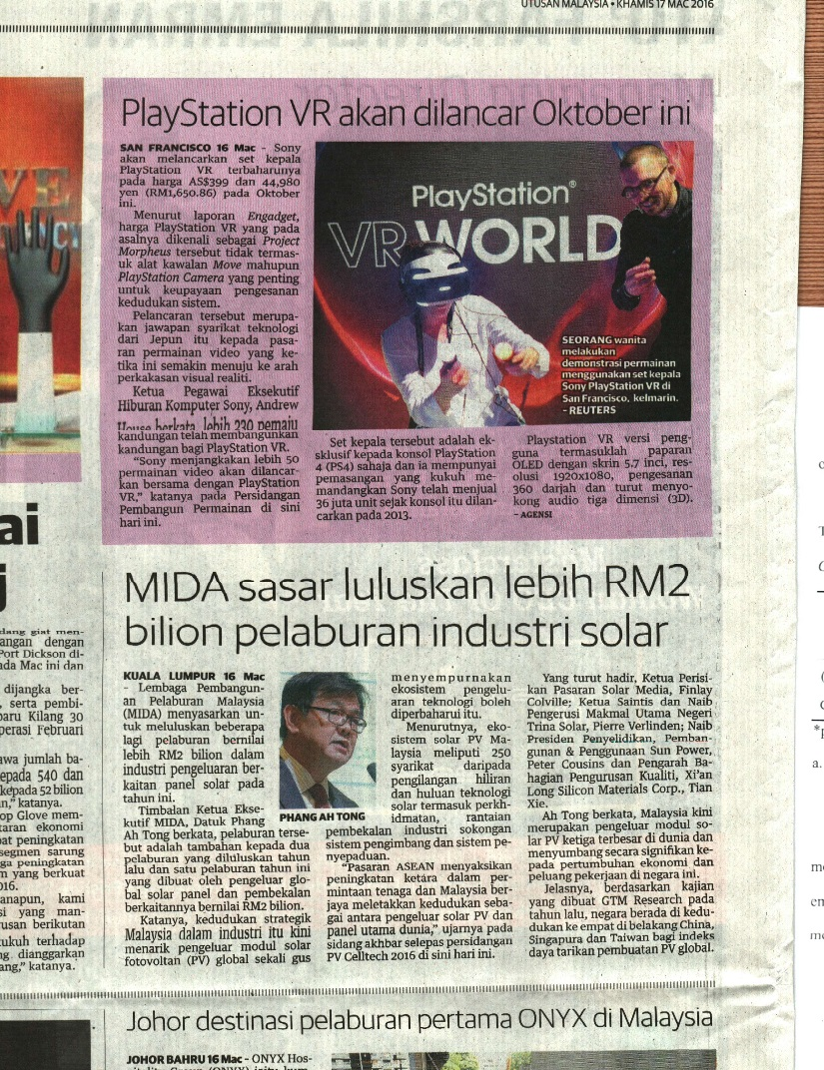
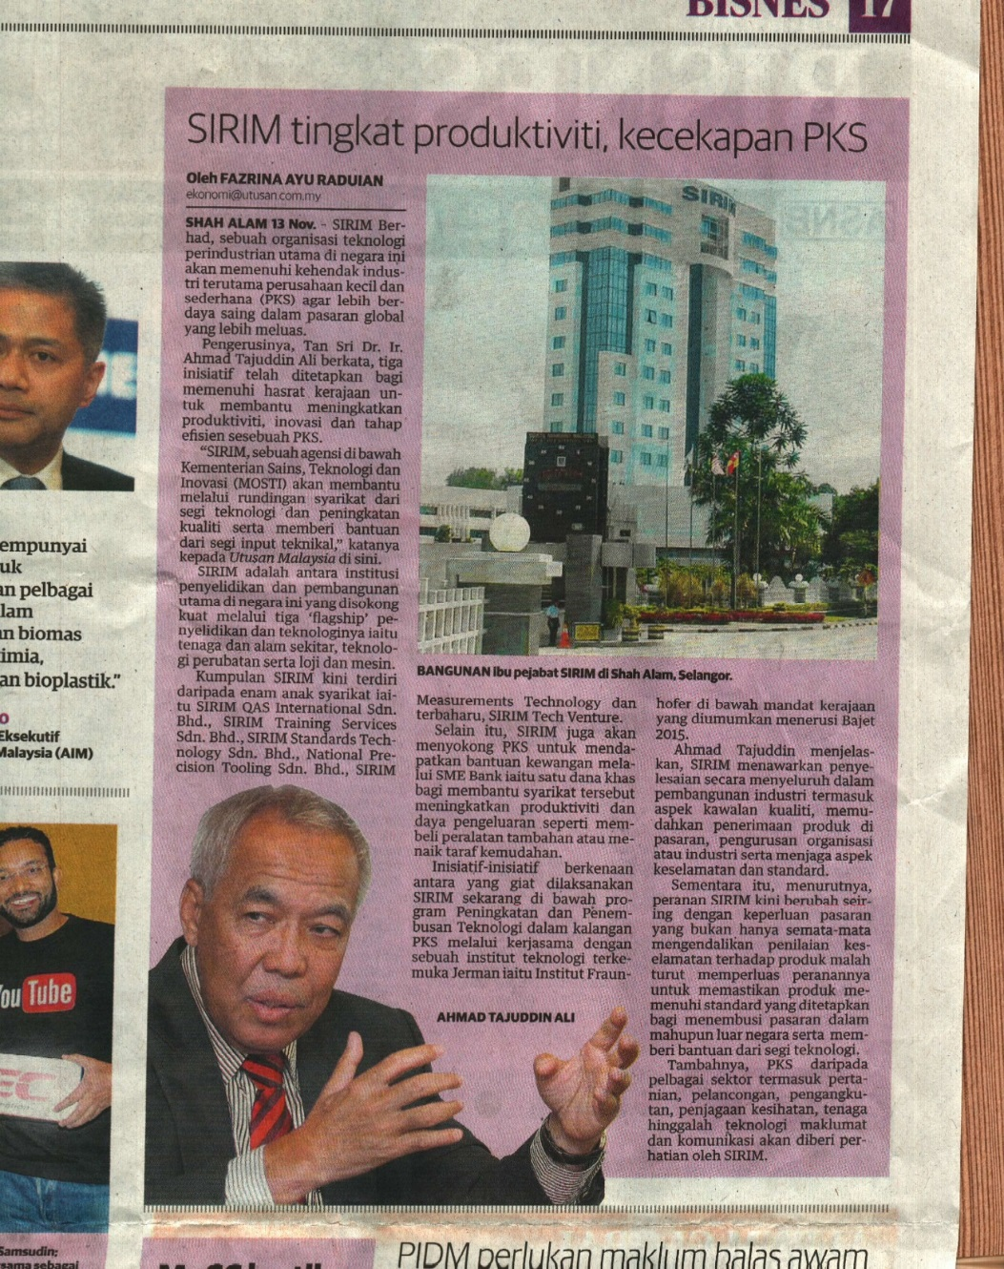
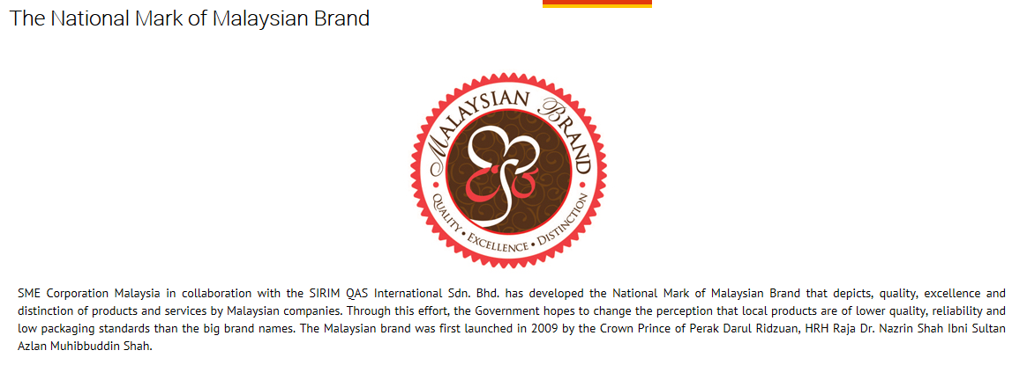

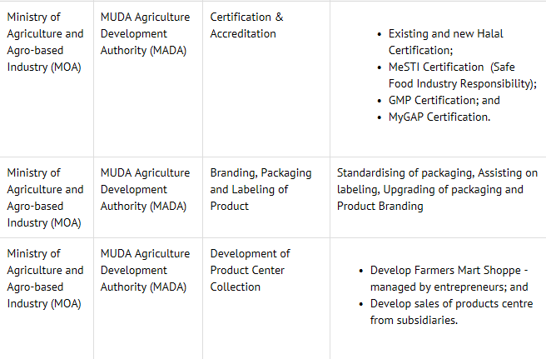
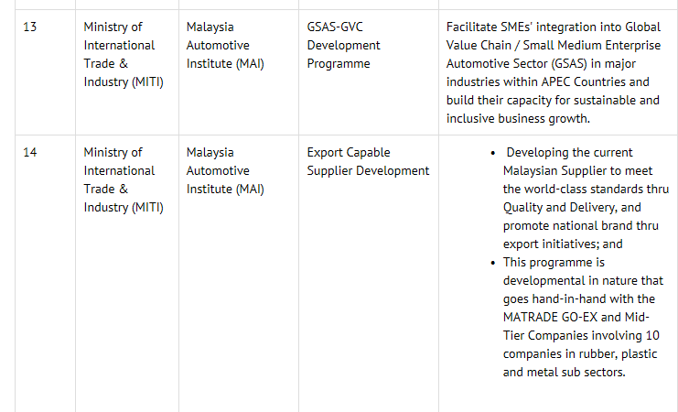
BUSINESS SUPPORT SYSTEM
TECHNOPRENEUR
Courses, Seminars
And Workshops
Technical
Assistance
Marketing
Assistance
Infrastructure
Assistance
Information
Assistance
Research and
Development
Financial
Assistance
Advisory
Services
Extension
Services
FPTT- UTeM

Slide 38

THANK YOU
Q & A

